Slide 1
Backtracking
Sum of Subsets

Slide 2

Sum of Subsets Problem: Given a set of positive integers, find the combination of numbers that sum to given value M.
Sum of subsets problem is analogous to the knapsack problem.
The Knapsack Problem tries to fill the knapsack using a given set of items to maximize the profit.
Items are selected in such a way that the total weight in the knapsack does not exceed the capacity of the knapsack.
The inequality condition in the knapsack problem is replaced by equality in the sum of subsets problem.
Given the set of n positive integers, W = {w1, w2, …, wn}, and given a positive integer M, the sum of the subset problem can be formulated as follows (where wi and M correspond to item weights and knapsack capacity in the knapsack problem):

Slide 3
Numbers are sorted in ascending order, such that w₁ < w₂ < w₃ < …. < w_{n}.
The solution is often represented using the solution vector X. If the ith item is included, set xi to 1 else set it to 0.
In each iteration, one item is tested. If the inclusion of an item does not violet the constraint of the problem, add it. Otherwise, backtrack, remove the previously added item, and continue the same procedure for all remaining items.
The solution is easily described by the state space tree.
Each left edge denotes the inclusion of wi and the right edge denotes the exclusion of w_{i}.
Any path from the root to the leaf forms a subset. A state-space tree for n = 3 is demonstrated in Fig

Slide 4
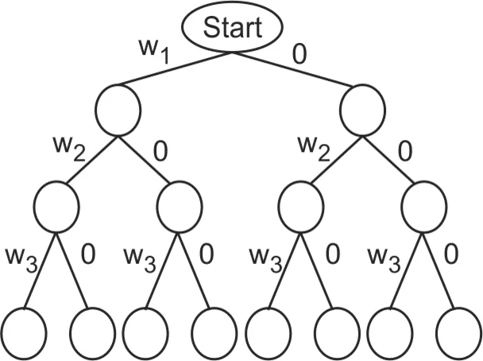
Fig: State space tree for n = 3

Slide 5
Backtracking
In Backtracking algorithm as we go down along depth of tree we add elements so far, and if the added sum is satisfying explicit constraints, we will continue to generate child nodes further.
Whenever the constraints are not met, we stop further generation of sub-trees of that node, and backtrack to previous node to explore the nodes not yet explored.
We need to explore the nodes along the breadth and depth of the tree.
Generating nodes along breadth is controlled by loop and nodes along the depth are generated using recursion (post order traversal).

Slide 6
Algorithm :
Start with an empty set
Add the next element from the list to the set
If the subset is equal to sum M, then stop with that subset as solution.
If the subset is not feasible or if we have reached the end of the set, then backtrack through the subset until we find the most suitable value.
If the subset is feasible (sum of subset < M) then go to step 2.
If we have visited all the elements without finding a suitable subset and if no backtracking is possible then stop without solution.

Slide 7
Problem: Consider the sum-of-subset problem, n = 4, Sum = 13, and w₁ = 3, w₂ = 4, w₃ = 5 and w₄ = 6. Find a solution to the problem using backtracking. Show the state-space tree leading to the solution. Also, number the nodes in the tree in the order of recursion calls.
Solution:
The correct combination to get the sum of M = 13 for given W = {3, 4, 5, 6} is [3, 4, 6].
The solution vector for [3, 4, 6] would be X = [1, 1, 0, 1] because element 5 is not chosen, so X[3] = 0.
Let’s derive the solution using backtracking. The numbers in W are already sorted.
Set X = [0, 0, 0, 0] ; Set Sum = 0. Sum indicates summation of selected numbers from W.

Slide 8
Step 1 : i = 1, Adding item w_{i}
Sum = Sum + w_{i} = Sum + w₁ = 0 + 3 = 3
Sum ≤ M(13), so add item i to solution set.
X[i] = X[1] = 1 ⇒ X =[1, 0, 0, 0]
Step 2 : i = 2, Adding item w₂
Sum = Sum + w_{i} = Sum + w₂ = 3 + 4 = 7
Sum ≤ M(13), so add item i to solution set.
X[i] = X[2] = 1 ⇒ X =[1, 1, 0, 0]

Slide 9
Step 3 : i = 3, Adding item w₃
Sum = Sum + w_{i} = Sum + w₃ = 7 + 5 = 12
Sum ≤ M(13), so add item i to solution set.
X[i] = X[3] = 1 ⇒ X =[1, 1, 1, 0]
Step 4 : i = 4, Adding item w₄
Sum = Sum + w_{i} = Sum + w₄ = 12 + 6 = 18
Sum > M(13), so backtrack and remove the previously added item from the solution set.
X[i] = X[3] = 0 ⇒ X =[1, 1, 0, 0].
Update Sum accordingly. So, Sum = Sum – w₃ = 12 – 5 = 7
And don’t increment i

Slide 10
Step 5 : i = 4, Adding item w₄
Sum = Sum + w_{i} = Sum + w₄ = 7 + 6 = 13
Sum = M(13), so solution is found and add item i to solution set.
X[i] = X[4] = 1 ⇒ X =[1, 1, 0, 1] A complete state space tree for given data is shown in Fig

Slide 11
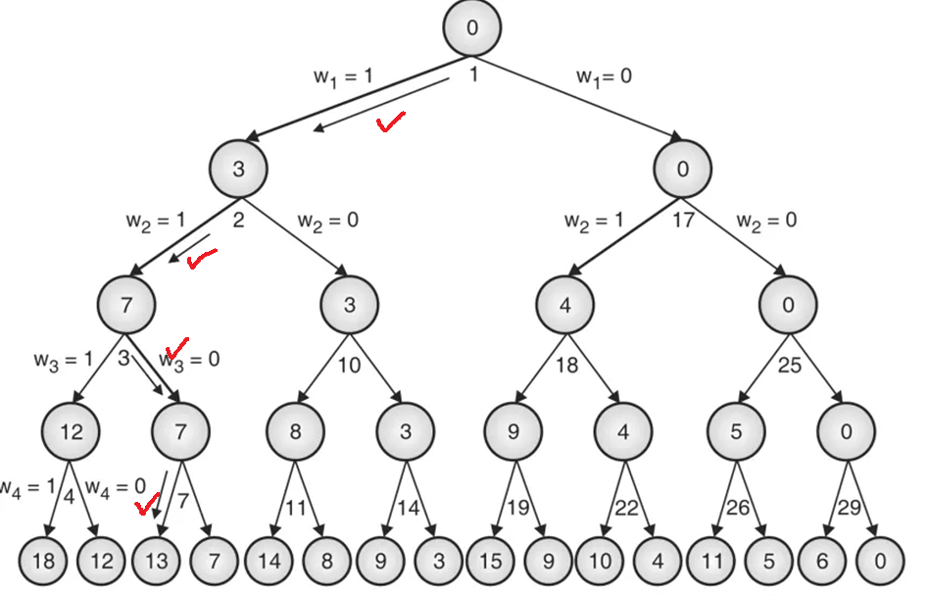

Slide 12
Complexity Analysis
It is intuitive to derive the complexity of sum of the subset problem. In the state-space tree, at level i, the tree has 2i nodes. So, given n items, the total number of nodes in the tree would be 1 + 2 + 2² + 2³ + .. 2^{n}.
T(n) = 1 + 2 + 2² + 2³ + .. 2^{n} = 2^{n+1} – 1 = O(2^{n})

Slide 13
Example:
Analyze sum of subsets algorithm on data :
M = 35 and
w = {5, 7, 10, 12, 15, 18, 20}

Slide 14
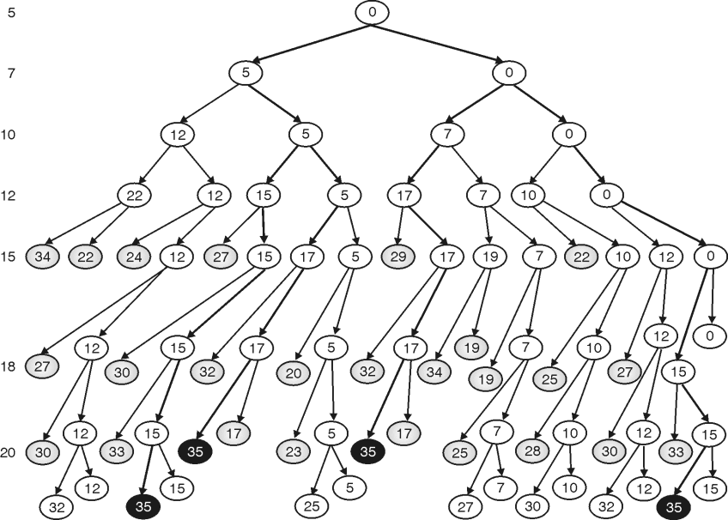

Slide 15
Example:
Analyze sum of subsets algorithm on data :
M = 35 and
w = {5, 7, 10, 12, 15, 18, 20}
Solution:
Let us run the algorithm on first instance
w = {5, 7, 10, 12, 15, 18, 20}.
Items in sub set | Condition | Comment
{ } | 0 | Initial condition
{ 5 } | 5 < 35 | Select 5 and Add next element
{ 5, 7 } | 12 < 35 | Select 7 and Add next element
{ 5, 7, 10 } | 22 < 35 | Select 20 and Add next element
{ 5, 7, 10, 12 } | 34 < 35 | Select 12 and Add next element

Slide 16
{ 5, 7, 10, 12, 15 } | 49 > 35 | Sum exceeds M, so backtrack and remove 12
{ 5, 7, 10, 15 } | 37 > 35 | Sum exceeds M, so backtrack and remove 15
{ 5, 7, 12 } | 24 < 35 | Add next element
{ 5, 7, 12, 15 } | 39 > 35 | Sub set sum exceeds, so backtrack
{ 5, 10 } | 15 < 35 | Add next element
{ 5, 10, 12 } | 27 < 35 | Sub set sum exceeds, so backtrack
{ 5, 10, 12, 15 } | 42 > 35 | Sub set sum exceeds, so backtrack
{ 5, 10, 15 } | 30 < 35 | Add next element
{ 5, 10, 15, 18 } | 48 > 35 | Sub set sum exceeds, so backtrack
{ 5, 10, 18 } | 33 < 35 | Add next element
{ 5, 10, 18, 20 } | 53 > 35 | Sub set sum exceeds, so backtrack
{ 5, 10, 20 } | 35 | Solution Found

Slide 17
There may be multiple solutions.
A state-space tree for the above sequence is shown here:
The number in the leftmost column shows the element under consideration.
The left and right branches in the tree indicate inclusion and exclusion of the corresponding element at that level, respectively

Slide 19
We get the four solutions:
{5, 10, 20}
{5, 12, 18}
{7, 10, 18}
{15, 20}
For efficient execution of the subset sum problems, input elements should be sorted in non-decreasing order.
If elements are not in non-decreasing order, the algorithm does more backtracking.
So second and third sequences would take more time for execution and may not find as many solutions as we get in the first sequence.

Slide 20
Pseudocode:
void subset_sum(int list[], int sum, int starting_index, int target_sum)
{
if( target_sum == sum )
{
subset_count++;
if(starting_index < list.length)
subset_sum(list, sum - list[starting_index-1], starting_index, target_sum);
}
else
{
for( int i = starting_index; i < list.length; i++ )
{
subset_sum(list, sum + list[i], i + 1, target_sum);
}
}
}

Slide 21
Example:
Solve the sum of subset problems using backtracking algorithmic strategy for the following data: n = 4 W =(w₁, w₂, w₃, w₄) = (11, 13, 24, 7) and M = 31.
Solution:
Items in sub set | Condition | Comment
{ } | 0 | Initial condition
{ 11 } | 11 < 31 | Add next element
{ 11, 13 } | 24 < 31 | Add next element
{ 11, 13, 24 } | 48 < 31 | Sub set sum exceeds, so backtrack
{ 11, 13, 7 } | 31 | Solution Found

Slide 22
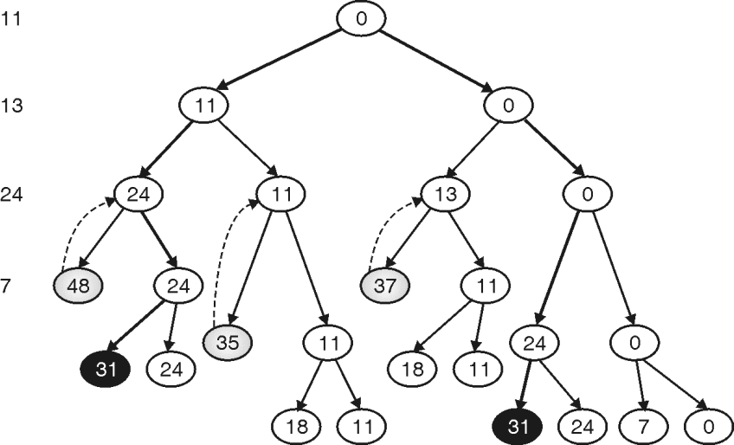
State-space tree for a given problem is shown here:

Slide 23
In the above graph, the black circle shows the correct result.
The gray node shows where the algorithm backtracks.
Numbers in the leftmost column indicate elements under consideration at that level.
The left and right branches represent the inclusion and exclusion of that element, respectively.
We get two solutions:
{11, 13, 7}
{24, 7}

